Slide 1
Chapter 2: Patterns, principles, and security models
Prof. E.B. Fernandez

Slide 2
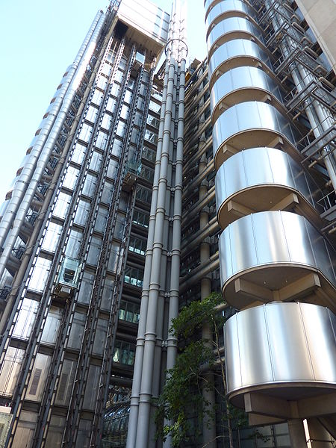
Patterns
A pattern is a solution to a recurring problem in a specific context
The idea comes from building architecture (Christopher Alexander)
It was applied initially to software but it has been extended to other aspects.
It appeared in 1994 and it is slowly being accepted by industry.

Slide 3
Value of patterns
A pattern addresses a recurring design problem that appears in some design step and provides a solution for it. It encapsulates the experience and knowledge of designers (best practices)
Patterns can be used to document design experience and record design decisions.
Patterns are sets of classes, above the abstractions presented by classes or objects, so they provide a larger unit of reuse.

Slide 4
Patterns II
Patterns provide a communication vocabulary for designers.
Patterns can be used as guidelines for new designs. The designer can know in this way which parts of a new system or product are fundamental and which ones can be added later.
Patterns can be used to evaluate existing designs. We can see if a product we are considering has features we consider important. Note that the existing system does not need to have been built using patterns.

Slide 5
Patterns III
Patterns can make complex standards easier to understand, implement, and use. Some standards are very complex and are described using low-level details; a good model makes them much clearer.
We can simulate specific systems by instantiating patterns to describe the system that we are considering. We can then perform a simulation and study aspects such as scalability, number of required messages between nodes, etc.
The UML classes in the pattern solution can be converted by the code generation part of a tool such as Rational Rose into C++ or Java or any other language. UML models are language independent. A good modeler can build better code and handle bigger systems that pure coders.

Slide 6
Why security patterns?
Analysis patterns can be used to build conceptual models of software, design patterns can be used to make software more flexible and reusable, and security patterns can be used to build secure systems, including software and hardware.
Security has had a long trajectory, starting from the early models of Lampson and Bell/LaPadula in the early 70s, and resulting in a variety of approaches to analyze security problems and to design security mechanisms. It is natural to try to codify this expertise in the form of patterns.
Security patterns describe mechanisms to stop or mitigate attacks, correct a vulnerability, and apply principles of good design

Slide 7
Value of security patterns
Can guide the use of security mechanisms in an application (stop specific threats)
Can apply security principles directly (Least privilege) or describe security mechanisms able to stop specific threats or that can correct a vulnerability
Can guide the design and implementation of the security mechanism itself, e.g. a firewall
Can help understanding and using complex standards (XACML, WS-Policy)
Convenient for teaching security principles and mechanisms

Slide 8
Security Patterns
Software Architecture
Security
Software
Engineering

Slide 9
Pattern mining
How do we find patterns?
Consider problems that appear in different systems, e.g. authentication
Look for analogies in systems. If two or more systems have similar ways of solving a problem you have a pattern
Search for commonalities in standards and regulations, e.g. HIPAA, Sarbanes-Oxley, FEMA, Web services security standards
From your own practice, remember similar solutions in other problems you have encountered

Slide 10
Pattern description: Templates
A template describes a pattern using a collection of sections that make explicit the function and use of the pattern
There are three commonly-used templates:
Gang of Four (GOF):
E. Gamma, R. Helm, R. Johnson, J. Vlissides
Principles of Software Architecture (POSA):
Buschmann et al.
C. Alexander (an architect of buildings)

Slide 11
POSA template
Intent (thumbnail)
Example
Context
Problem and forces
Solution: in words, UML models (static and dynamic)
Implementation
Example resolved
Known uses
Consequences
See also (related patterns)

Slide 12
Using the patterns
Catalogs of patterns are not enough, designers must be given guidance in their use
There are many patterns (growing in number) and the task of selecting them gets harder
A first approach is to classify the patterns according to some criteria, e.g., architectural levels where they are used

Slide 13
Sec Pattern classification
Use a multidimensional matrix
Dimensions may include: architectural level, lifecycle stage, concern, type of pattern, domain,…
Example: XACML

Slide 15
Security layers

Slide 16
Threat/Misuse patterns
Describe threats and misuses from the point of view of the attacker.
They use sequence diagrams (and more details) to describe how an attacker performs a misuse, they describe attack scenarios
The pattern tries to show how the attacker works (modus operandi) so we can apply defenses to stop it
The objects in the sequence diagram represent architectural units of the target system that can be searched to collect evidence (forensics)

Slide 17
1..
1..
Application
*
UseCase
*
Activity
Threat
Pattern
encapsulates
*
targets
*
1
Threat
Asset
1
1
*
*
1
*
1
realizes
realizes
1
1
*
1
1
Attack
exploits
Vulnerability
Attack
Pattern
1..
*
*
*
encapsulates
realizes
*
neutralizes
1
Misuse
Pattern
*
SSF
*
*
SC
1
Security
Pattern (SP)
1..
*
SP Family
1..
*
0..1
Compound SP
Simple SP
ASP

Slide 18
Principles to build secure systems
To design secure systems we should apply good principles
Several principles have been extracted from experience
The first set came from a 1975 paper:
J. H. Saltzer and M. D. Schroeder, “The protection of information in computer systems”, Procs. of the IEEE, vol. 63, No 9, Sept.1975, 1278-1308.
Other principles have been added later
If we build systems using patterns we can apply those principles implicitly

Slide 19
Security principles for system design
Closed system. Anything not explicitly allowed is forbidden. Here the policy is applied to application rights and to process resource access during execution.
Open design. When the mechanism is subject to public scrutiny it is easier to find flaws and with time it becomes increasingly secure. Some of the data used in the security system could be secret though, e.g., passwords, keys.
Least privilege. This is the application of a basic security policy at all design levels.
Economy of mechanism. The security mechanisms should be as simple and small as possible. This makes comprehension, testing, and analysis easier.

Slide 20
Security principles II
Complete mediation. Every request for access must be validated.
Minimal trust. The parts of the system that must be trusted should be minimal.
Separation of privilege. Critical actions may need two independent mechanisms to agree before being performed.
Least common mechanism. Minimize the amount of mechanism common to more than one user and depended on by all users.
Ease of use or transparency. Users must accept the security system or they will not use it. Security functions must be transparent or at least easy to use.
Information hiding and encapsulation. Implementation details should not be exposed, only a clear, functional interface should be shown. This principle comes from [Neu86] and points toward object-oriented design.

Slide 21
Security principles III (I found these in several places)
Holistic approach--Cover all architectural levels and all units, apply security in all phases of system design
Highest level—security constraints must be defined where their semantics are clear and propagated down
Defense in depth—have more than one line of defense
Separate and compartmentalize –isolate units that do related work at execution time
Safe defaults—failures (crashes) should close everything for access, everything not explicitly granted is forbidden
Submarine principle—we can accept to lose some units but we preserve essential units
We can also define principles for specific systems

Slide 23
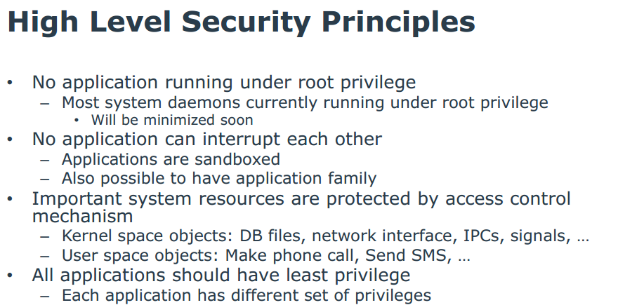
Tizen OS (Samsung)

Slide 24
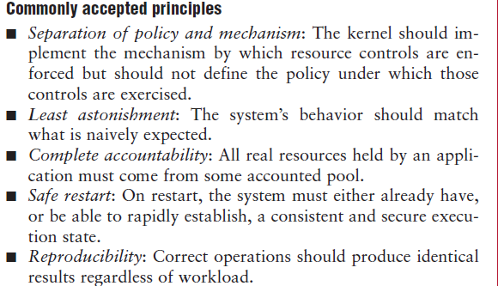
Principles used in the EROS OS J. Shapiro, IEEE Software, Jan/Feb 2002

Slide 25
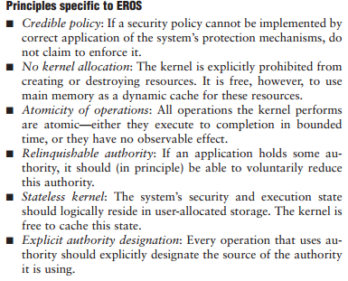

Slide 26
Kerkhoff’s principle (from the Wikipedia)
In cryptography, Kerckhoffs' principle (also called Kerckhoffs' desideratum, Kerckhoffs' assumption, axiom, doctrine or law) was stated by Dutch cryptographer Auguste Kerckhoffs in the 19th century: A cryptosystem should be secure even if everything about the system, except the key, is public knowledge.
Kerckhoffs' principle was reformulated (or perhaps independently formulated) by American mathematician Claude Shannon as "the enemy knows the system", i.e., "one ought to design systems under the assumption that the enemy will immediately gain full familiarity with them". In that form, it is called Shannon's maxim. In contrast to "security through obscurity", it is widely embraced by cryptographers.

Slide 27
Another principle
It is preferable to have a secure architecture with insecure code that secure code with an insecure architecture
Reason: The first combination is easier to fix and it is harder to attack

Slide 28
Security models
Classification
Access matrix
Role-Based Access Control
Multilevel security

Slide 29
Models
Security models are a more precise and detailed expression of policies and are used as guidelines to build and evaluate systems. Usually they are described in formal or semi-formal way.
Models can be discretionary or mandatory. In a discretionary model, holders of rights can be allowed to transfer them at their discretion. In a mandatory model only designated roles are allowed to grant rights and users cannot transfer them
An orthogonal classification divides models into those based on the access matrix, Role-Based Access Control, and multilevel models. The first two of these models control access while the last one attempts to control information flow. Mandatory and discretionary models can be combined with the access matrix and the multilevel model.

Slide 30
Classification of authorization models
Multilevel --users and data are assigned security levels
Access matrix -- subject has specific type of access to data objects
Mandatory --access rules defined only by administrators
Discretionary -- users own data and can grant access to other users

Slide 32
Access matrix authorization rules
Basic rule ( s, o, t ) , where s is a subject (active entity), t is an access type, and o is an object
Extended rule ( s, o , t , p,f) , where p is a predicate (access condition or guard) and f is a copy flag
This, and the other models, can be described by OO patterns

Slide 33
Access Matrix
 | Database A | Component Q | Interface F
Alice | Read-Write; Always | Hire | Yes
Bob | Read-Write; Between 9 and 5 | Fire | No
Charles | No access | Modify salary | No
Dave | No access | AssignTo Unit | Yes
Eve | Read-only; Always | Evaluate | No

Slide 34
Administrative rights
transfer{t/t*} to M(s,o)---transfer can be destructive or not, depending on the policy.
grant{t/t*} to M(s,o)—in a grant both grantor and grantee have the right after the grant.
delete t from M(s,o)—a right is removed from a subject.
read M(s,o)—inspect the right of a subject for an object.
create object o
delete object o
create subject s
delete subject s

Slide 35
Authorization pattern

Slide 36
Authorization mapping

Slide 37
Role-Based Access Control
Users are assigned roles according to their functions and given the needed rights (access types for specific objects)
When users are assigned by administrators, this is a mandatory model
Can implement least privilege and separation of duty policies
Reduces number of rules

Slide 38
Basic RBAC pattern

Slide 39
Growing models
We can grow models by adding classes, e.g. from Authorization to RBAC we add a Role class.
We can add sessions as execution context
We can add hierarchies of roles and of objects (Composite pattern)
Subroles inherit role rights from superclass roles.
Access to an object gives implicit access to its subobjects

Slide 41
More extensions to RBAC
Separation of administrative roles: administrators have special rights to create users, roles, grant rights,…
Groups of users: a set of users taken as a whole for access rights
8/23/2018
41

Slide 42
Extended RBAC pattern

Slide 43
Role rights for financial institution
Customers can open/close accounts
Customers can initiate trade
Broker can perform trade
Auditor can inspect (read) trade transactions
8/23/2018
43

Slide 44
8/23/2018
44

Slide 45
Implied authorization
For convenience we may need to group or structure subjects, protection objects, and some access types in such a way that they may imply others in some ordering structure. In this case, a rule component may be implied by another rule and this must be taken into account when evaluating access.
The concept of implied authorization was introduced in [Fer75b] and subsequently has been applied in some research projects and used in the later versions of the Windows operating system (starting with NT Version 4.0) and the .NET component authorization. It has also been applied to object-oriented databases where access rights can be inherited along generalization or aggregation hierarchies as we discuss in the chapter on database systems.

Slide 46
Multilevel models
Because of the way they control security they have also been called data (information) flow models, they control the allowed flow of data between hierarchical levels. These models have been formalized in three different ways:
The Bell-La Padula model, intended to control leakage of information between levels.
The Biba model, which controls data integrity.
The Lattice model, which generalizes the partially ordered levels of the previous models using the concept of mathematical lattices.

Slide 47
Features of the multilevel models
Users and data are assigned classifications or clearances
They are mandatory models (users are assigned to classifications by administrators)
Classifications include levels (top secret, secret,…), and categories (compartments) (engDept, marketingDept, Army, …)
Typically use data labels (tags) to indicate their classifications or levels, used to enforce security
In each level an access matrix may further refine access control.
Need trusted processes to perform administrative functions (e.g., declassify documents, increase a user’s clearance) so secure flow of control is not violated

Slide 48
Categories and levels
Army
Navy
Air Force
Top Secret
Secret
Levels
Confidential
Classified

Slide 49
Bell-LaPadula rules (confidentiality)
Simple security (ss) property. A subject s may read object o only if its classification dominates the object’s classification, i.e., C(s) => C(o). This is the no read-up property.
*-Property. A subject s that can read object o is allowed to write object p only if the classification of p dominates the classification of o, i.e., C(p) => C(o). This is the no write-down property.
A security classification dominates another if and only if its level is greater or equal than the other level and its categories include the other categories. For example, in the next figure, level L1 dominates level L2. Security levels L1 and L3 or L2 and L3 are incomparable.

Slide 51
Example of Bell and LaPadula Model
O₅
high
(w)
(w)
S₂
O₄
(r)
(r)
O₃
(w)
(w)
S₁
O₂
(r)
(r)
low
O
S
O₁

Slide 52
The Biba integrity model
Biba’s model classifies the data into integrity levels and defines two properties dual to the simple security and * properties. This model includes the properties:
Single integrity property. Subject s can modify object o only if I(s) >= I(o).
Integrity *-property. If subject s has read access to object o with integrity level I(o), s can write object p only if I(o) >= I(p).
The first property establishes that an untrusted subject cannot write in objects of a higher level of integrity or she would degrade that object.
The * property protects information from flowing up the hierarchy

Slide 53
Biba Model (2)
BLP
BIBA
O₅
high
(w)
(r)
(w)
S₂
O₄
(r)
(r)
(w)
(w)
O₃
(w)
(r)
(r)
(w)
(w)
S₁
O₂
(r)
(r)
(w)
(w)
O₁
low
(r)

Slide 54
Multilevel security pattern (BellLaPadula)

Slide 55
Enforcement of authorization
Regardless of how we define authorization rules, we need to enforce them.
An abstract rule enforcer is a Reference Monitor (RM)
When an RM is implemented in a system it must include authentication information and authorization rules, we call this a Policy Enforcement Point (PEP)
The data needed for A&A is called Policy Definition Point (PDP)

Slide 56
Reference Monitor
Each request for resources must be intercepted and evaluated for authorized access
Abstract concept, implemented as memory access manager, file permission checks, CORBA adapters, etc.

Slide 57
Reference Monitor idea

Slide 58
Reference monitor pattern (basic idea)

Slide 59
Reference monitor (with reified Decision)

Slide 60
Enforcing access control

Slide 61
Where to apply the controls:
Account
Customer
TX
Authentication
Authentication
Authorization
Logging

Slide 62
Authentication, Authorization, and Logging
After a user is recognized as a legitimate user by the Authentication system she is admitted to the system.
For the user to access specific resources (memory, files, I/O devices) or data items she needs Authorization rights.
For every access (read or writes) to data, a Logging system records the data item accessed, the time, the type of access, and the user who performed the access.
The log can be audited later to check the proper use of the data.

Slide 63
Governance
Governance means establishing and enforcing how a group agrees to work together in co-ordination. Specifically, governance is the establishment of:
Chains of responsibility to assign duties and rights to people (role engineering)
Measurement to gauge effectiveness
Policies to guide the organization to meet its goals
Control mechanisms to ensure compliance with regulations and policies
Communication to keep all required parties informed
Governance determines what decisions are to be made, who should be making the decisions and what policies should be considered before making any decisions Management defines ways to apply specific aspects of governance to the control of cloud resources

Slide 64
References
[Gad14] Olga Gadyatskaya; Fabio Massacci; Yury Zhauniarovich, “Security in the Firefox OS and Tizen Mobile Platforms”, Computer , 2014, Volume: 47, Issue: 6 , 57 - 63, DOI: 10.1109/MC.2014.165
[Sal75] J. H. Saltzer and M. D. Schroeder, “The protection of information in computer systems”, Procs. of the IEEE, vol. 63, No 9, Sept.1975, 1278-1308.
SANS, “Information security policy templates”, http://www.sans.org/security-resources/policies/

Slide 65
Authentication
Before they can perform any activities in the system both users and systems must identify themselves and be authenticated.
Identification and Authentication (I&A) use some kind of protocol to establish identity.
I&A is the basis for authorization and for logging, it provides accountability.
Once verified, the system may provide a proof of authentication and a handle (reference) to the user’s account. For example, IBM’s z/OS provides an accessor environment element (ACEE), which follows the authenticated process during its execution
.

Slide 66
System
legitimate
authorization
user
resources
X
X
hacker
authentication

Slide 67
Approaches to authentication
Something the user knows. Passwords are the most common example of this type.
Something the user has. Typically a smart card.
Something the user is (biometrics). A body feature of the user, e.g. her fingerprints, is used to authenticate the user.
Where the user is. The location of the user is enough to grant him access

Slide 68
Formally
An authentication system can be defined formally as a 5-tuple (A,C,F,L, S), where A is the information needed to prove identity, C is the information used to validate the user request, F is a complementation function f: A → C; L is a set of functions used to validate identity, and S are functions to let the user create or modify information in A or C.
In a password system: A are the strings that correspond to the user-chosen passwords, C is the list of passwords in the system, F is the identity function {I}, L is the equality function {=}, and S is a function to set or change passwords.

Slide 69
Authentication hierarchy
Starting from an abstract authentication pattern we can define more specific (concrete) authentication methods
An Abstract Security Pattern (ASP) is a security pattern that describes a conceptual semantic restriction in a domain which can be a defense to a threat or a way to comply with a regulation, with no implementation aspects [Fer14].
An ASP describes the essential functions that must be present to handle a threat or regulation in an implementation-independent way. For example, “only the owners of accounts in a financial institution are permitted to withdraw money from them” is a typical semantic restriction. A concrete pattern describes a security solution within a technological context, e.g., distributed systems, XML web services, etc.

Slide 70
An authentication hierarchy

Slide 71
Class diagram of Authenticator

Slide 72
Sequence diagram for the use case “Authenticate a subject”

Slide 73
Threats for the Abstract Authenticator
T1. Present fake or stolen proof of identity, to let the attacker impersonate a legitimate subject.
T2. Steal the proof of authentication.
T3. Unauthorized reading of authentication (identity) information.
T4. Unauthorized modification of identity information.
T5. Register a subject using false information.

Slide 74
Passwords
Passwords are considered a relatively weak approach. Most passwords are easy to find using a good dictionary, educated guesses, and a program that tries them in succession.
For better security the Unix password system uses slower encryption, produces less predictable passwords with a password generator, and uses ‘salting’. Salting implies that the password is encrypted using the concatenation of the time of the day and the process id as a key; the encrypted password is then concatenated with the time of the day and the process id.
The main problems with passwords are that users choose poor passwords and that they are kept for long periods of time, which means that the attacker has time to find a way to discover them.
A common attack is to get a copy of the encrypted passwords (some systems don’t protect the password file itself) and perform dictionary or exhaustive attacks.

Slide 75
Password-based authentication

Slide 76
Smart cards
A card with some processing power is used to establish the connection. Smart cards use a PIN provided by the user and other information such as date, time, or name of the user to send an encrypted message to the system (typically some Authentication Server). Only if the system can decipher the message the user is connected.
The card must be tamper-resistant to prevent a person who steals the card from finding the PIN in the card. Given that these cards have a significant amount of memory there have been proposals about including in them financial, health, and employment information about their owners, although this may bring additional privacy problems.
More secure but more costly than passwords, can be lost of stolen.
Frequently used by employees of a company to connect remotely to their systems.

Slide 77
Biometrics
This is the use of some unique personal characteristic, e.g., fingerprints, retina scan, face contour, face recognition, signature dynamics. This can be a more secure approach but it is more expensive and slower than the other two.
Fingerprint recognition security has been put in doubt, people leave their fingerprints in many places and gummy fingers appear to fool most systems.
They require a large amount of data. If their digital representation is compromised they cannot be replaced.
After the September 11 attacks this approach has become considerably more popular. This popularity has also been helped by the decreasing cost of some of these approaches.

Slide 78
Multifactor authentication
For higher security we can use Multi-factor Authentication, using two of the three authentication factors: something the user has, something the user knows, and something the user is.
For example, Google can send you text messages, with a code sent to your phone (something you have) every time you log in with a password (something you know) or as most banks use for their online banking a security question that (supposedly)only you can answer(something a user knows).

Slide 79
Known uses
Windows Office 365--Will send a security code to your phone or your alternate email address.
Google--a code will be sent to your phone via text, voice call, or our mobile app. Or, if you have a Security Key, you can insert it into your computer’s USB port.
Bank of America--You will be asked three random questions that only you know how to answer.
Apple--You can only sign in through an approved device and your Apple Id.
Department of Defense--Uses the YubiKey along with a one time password
Others include: Wordpress, Facebook, Twitter, and DropBox.

Slide 80
Identity management
Authentication relies on uniquely identifying users and other entities, and requires an identity management system that has information about all the legitimate users of the system
Users can have more than one identity, related to their roles
Each identity is defined by a set of attributes
There are identity standards: Liberty Alliance (IBM, Visa, HP…), Microsoft Account (MSA)

Slide 81
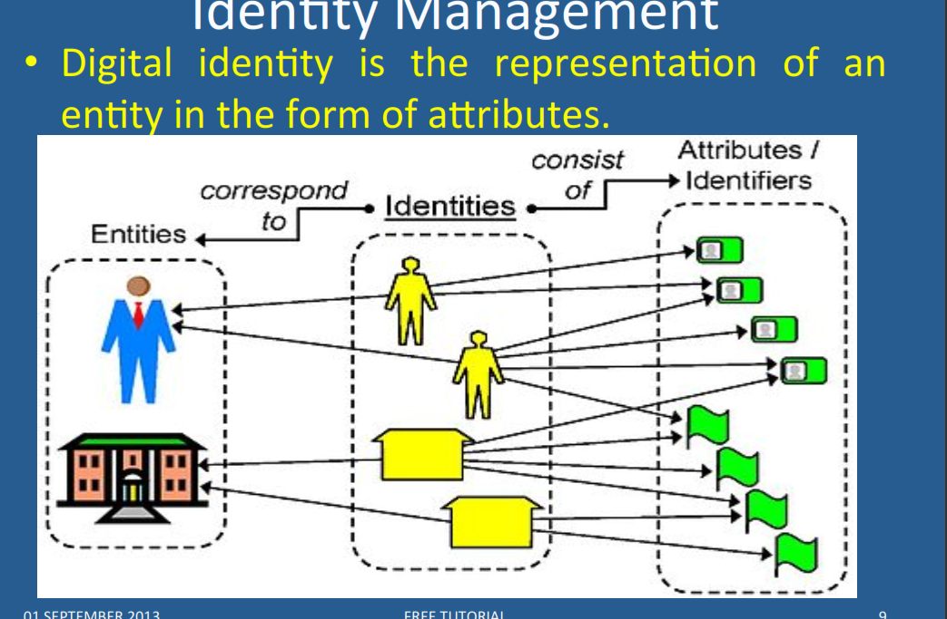

Slide 82
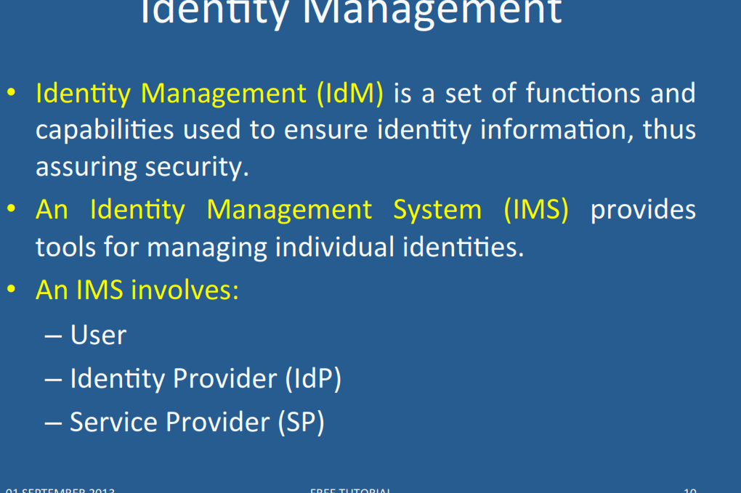

Slide 83
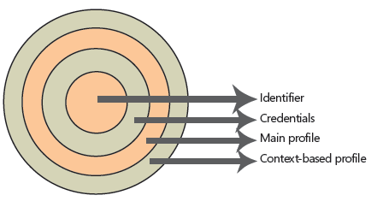
Digital identities

Slide 84
Identities
The innermost layer is the unique identifier of this digital identity. There should be no identical unique identifiers in the same security domain. Users must have unique identifiers to be easily recognizable by any system to which they have access.
To have access to this identifier, the user must present to the security system a set of credentials that will be checked against the computing secrets stored in the identity database. A user is entitled to access her own unique identifier if and only if she presents the correct set of credentials to unlock this magic number.
After the user unlocks the unique identifier, a set of common attributes (called the main profile) is accessible to a system that may require a little more knowledge than the unique identifier itself. This can be, for example, the user name, department, Social Security number, company name, and so on. These attributes do not vary from system to system; they are the same wherever the user logs on. They are a fixed set of values that are tied to the user during the lifetime of the logon session.

Slide 85
Identities II
But not all systems need to share information.
There are sets of information that are only meaningful in the context of a system or related systems. For example, frequent flier miles are meaningful only under the context of an airline carrier, losing most of its meaning if moved from one carrier to another. But they share the same semantic context when used by the mileage program associates (restaurants, hotels, credit cards, and so on). These sets of attributes are stored in the context-based profile.
One digital identity can have only one unique identifier, a limited set of credentials (username/password pair, digital certificate/pin number pair, biometrical data), a unique set of main profile attributes, and an unlimited set of context-based profile attributes.

Slide 86
An example of an authentication server

Slide 87
Distributed identities
A user in a domain may use her identity in several autonomous systems if they trust each other and form an identity federation.
Each involved domain must have its own service provider
Identity providers issue credentials accepted by the members of the identity federation
The SSO in the next slide shows the idea: a user gets authenticated in her domain and then accesses another domain using SAML
We wrote a set of patterns for these three concepts

Slide 88
(Single Sign On) SSO pull model

Slide 89
Identity management patterns

Slide 90
Identity Federation

Slide 91
Circle of Trust
The Circle of Trust pattern allows the formation of trust relationships among service providers in order for their subjects to access an integrated and more secure environment.
Context: Service providers that provide services to consumers (subjects) over large systems such as the Internet.

Slide 92
Circle of trust class diagram

Slide 93
Identity Provider
The Identity Provider pattern allows the centralization of the administration of subjects’ identity information for a security domain.
Context: One or several resources, such as web services, CORBA services, applications, etc, that are accessed by a determined set of subjects. The subjects and resources are typically from the same organization.
Problem: Each application, or service may implement its own code for managing subjects’ identity information, leading to an overload in implementation and maintenance costs and that may lead to inconsistencies across the organization’s units.

Slide 94
Identity Provider class diagram

Slide 95
Identity Federation
The Identity Federation pattern allows the formation of a dynamically created identity within an identity federation consisting of several service providers. Therefore, identity and security information about a subject can be transmitted in a transparent way for the user among service providers from different security domains.
Problem: There may be no relationship among some of the security domains accessed by a Subject. Thus subjects may have multiple unrelated identities within each security domain. Consequently, they may experience multiple cumbersome registrations, authentications and other identity-related tasks prior to accessing the services they need.

Slide 96
Identity Federation

Slide 97
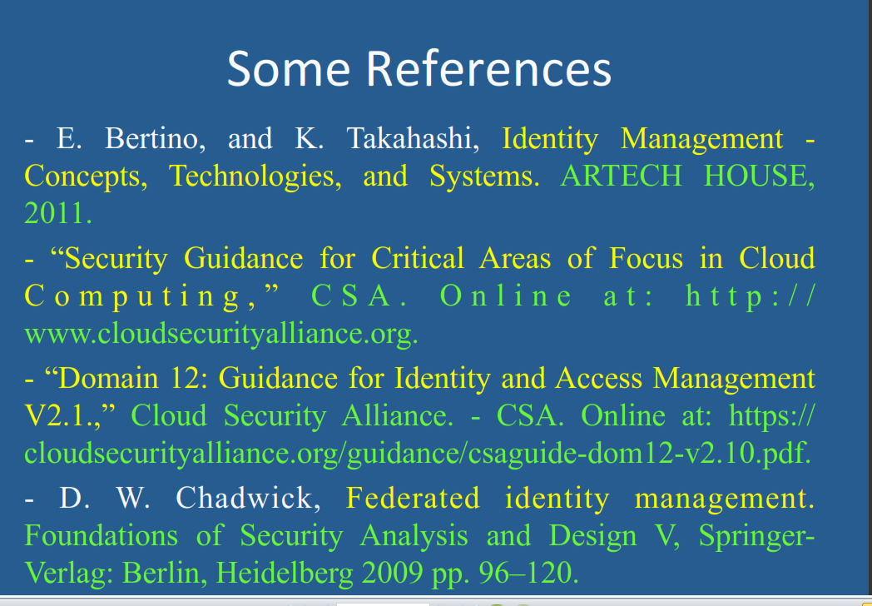

Slide 98
References for Identity
N. Delessy, E.B.Fernandez, and M.M. Larrondo-Petrie, "A pattern language for identity management", Procs. of the 2nd IEEE Int. Multiconference on Computing in the Global Information Technology (ICCGI 2007), March 4-9, Guadeloupe, French Caribbean.
http://www.computer.org/portal/web/csdl/doi/10.1109/ICCGI.2007.5
E.B.Fernandez, “Security patterns in practice: Building secure architectures using software patterns”, Wiley Series on Software Design Patterns, 2013. Chapter4: Identity Management
J. Rodriguez and J. Klug, “Federated identity patterns in a service-oriented world”, Microsoft Architecture Journal, 16, 6-11.
SOA Patterns, “Federated identity”, http://soapatterns.org/federated_identity.php

